Slide 1
Daily Journal: Python User Experience
By: Jeremy Griffen, Justin Harlow, and Ari Eastman
Fall 2023, CS-150

Slide 2
Introduction
The daily journal was the chosen task based on the Group Programming project guidelines. This was chosen because:
It worked to be a comprehensive and robust way for a user to log their experiences in a modern way.
Compared to other projects, it seemed relatively straight forward and worked with all our current capabilities in python.
The resources needed to guide with the daily journal were more easily found in the notebooks and programming assignments compared to the other choices which required more out of class learning which didn’t work well within the time constraints.

Slide 3
Journal Overview
Purpose:
The goal of this project is to create a simple daily journal application that allows users to log daily entries and be able to search and find previous entries.
Features:
Users can input new entries with date, text, tags, and an optional image.
Users can search for a previous entry using date, text, or tags used in a past entry.
Important Code:
Class, Functions, While loop, If-else statements

Slide 4
Technical Details:
Class:
A class is a blueprint that defines the attributes and behaviors of an object. It has data and functions that operate on that data.
Functions:
Functions are blocks of code that perform a specific task.
While loop:
A while loop repeatedly executes a code as long as a condition is true.
If-else statements:
If-else statements are used for decision-making in programming. They allow code to take different paths based on conditions.

Slide 5
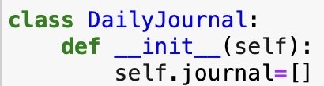
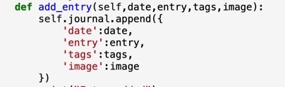
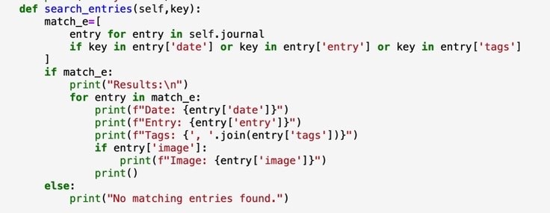
Implementation of Class and Functions:
__init__(self): Initializes an instance of the class. It creates an empty list called journal to store journal entries.
add_entry(self, date, entry, tags, image): This adds a new entry to the journal. It takes in date, the journal text, tags, and an optional image. It creates a dictionary with these aspects and appends it to the journal list.
search_entries(self, key): This is for searching entries based on a key. It goes through the journal list and looks for matches in the date, entry, or tags of each entry. If it finds matches, it prints the date, entry, tags, and image, if there is one, for each matching entry. Else, it prints "No matching entries found".

Slide 6
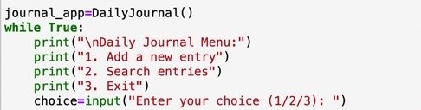
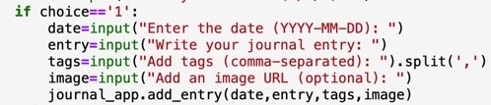


Implementation of Main Program Loop:
An instance of the DailyJournal class is created: journal_app = DailyJournal(). A while loop will present a menu to the user until the user chooses to exit.
Add a New Entry (choice == '1') will ask the user for the date, journal entry text, tags (comma-separated), and an image. It then calls the add_entry function of the journal_app object to add this entry to the journal.
Search Entries (choice == '2') will ask the user for a key to search entries. It then calls the search_entries function of the journal_app object to find and display entries that match the provided key.
Exit (choice == '3') will print "Goodbye" and exit the loop. Else, print “invalid choice”

Slide 7
Challenges and Solutions:
While developing the Daily Journal, one challenge we faced was implementing the "search entry" function. As more functionalities are added, the "search entry" function becomes longer and more complex, making it hard to read and figure out what is going on. To overcome this, we implemented a for loop that checks for each "date," "entry," and "tags."

Slide 8
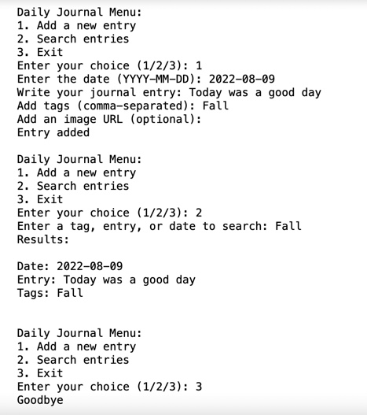
User Experience:
If the user selects #1 "Add a new entry" , they are prompted to input the date, journal entry, tags, and an optional image. Upon entering this, the entry is added to the journal
If the user selects #2 "Search entries", they are prompted to enter a key, which can be a tag, an entry text, or a date. If matches are found, the program displays the matching entry.
If the user selects #3 "Exit", the program says goodbye and ends.

Slide 9
Demonstration:
https://github.com/JGiffen/GP1_JTG_AGE_JFH

Slide 10
What we learned:
Throughout the working on the project, we gained insights into optimizing the functionality of Python such as better utilizing a for loop given our search entry.
We learned how to design code with functions and classes, as well as implementing user interaction.
How to better handle errors and how to fix them when trying to complete a programming task.

Slide 11
Conclusion:
Overall:
The project was informative in experience but also informed us of our current ability in python & programming with the semester ending soon.
The task we chose uniquely taught us on how python utilizes user input and how it's very creative for problem solving
How to implement user design to make it more user friendly
How to program as a group and over Mutiple computers using python concisely
Ultimately, The task we implemented succeeded and worked as our group programming project concisely and uniquely.

